Slide 1
COMMUNITY SERVICE PROJECT PLANTATION
VISAKHA INSTITUTE OF ENGINEERING AND TECHNOLOGY
NARAVA
VISAKHAPATNAM,ANDHRAPRADESH
Department of Computer Science & Engineering

Slide 2
PRESENTED BY:
20NT1A0548 – KAVALA BHASKARA DURGA
20NT1A0549 - KETHINENI ADARDA
20NT1A0550 - KONA VINEELA
20NT1A0527 – PANDULA ARJUNA RAO

Slide 3
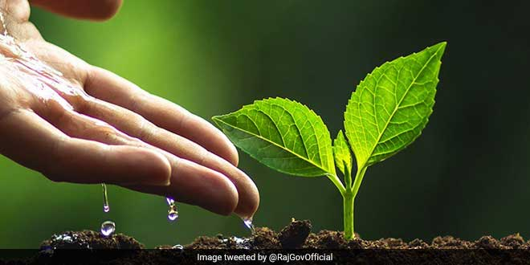
INTRODUCTION
A plantation is a long , artificially-Established forest, farm or estate, where crops are grow for sale, often in distant markets.
Tree plantation is the process of transferring of seedlings from one place to another for different purposes.
Furthermore, there are various reasons behind tree plantation but the most important are forestry, land reclamation, and landscaping.
Each process of tree plantation is important and unique in its own way.
Tree planting is the process of transplanting tree seedlings, generally for forestry, land reclamation , or landscaping purpose.

Slide 4
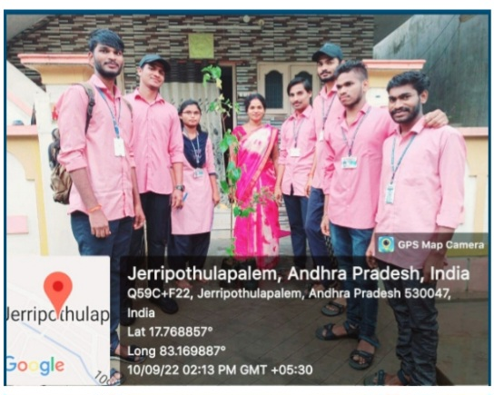
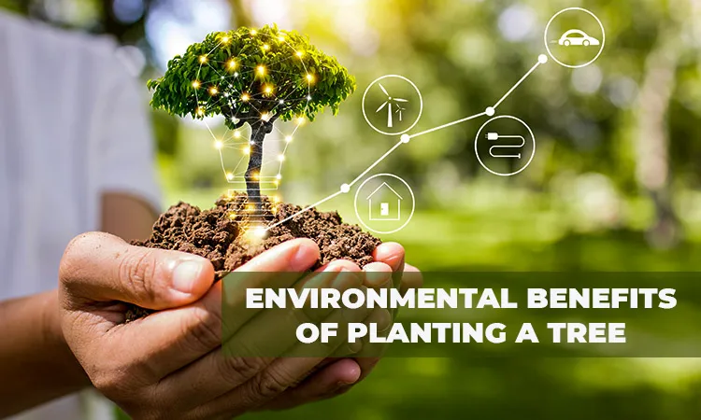
What is Tree plantation ?
Tree-planting is the process of transplanting tree seedlings, generally for forestry, land reclamation, or landscaping purpose.
Trees contribute to their environment by providing oxygen, improving air quality, climate amelioration, conserving water, preserving soil, and supporting of photosynthesis, trees take in carbon dioxide and produce the oxygen we breathe.
A tree plantation , forest plantation, plantation forest or timber plantation is a forest planted for wood, usually by planting one type of tree as a monoculture forest.
Trees provide food, protection, and homes for many birds and mammals.
Trees help us giving us fruit, wood, flowers, and fuel.

Slide 5
OBJECTIVES
Protest cutting trees and promote plantation.
Stop using plastic tags, Bags for commodities in retail stores.
Foot path facilities. 95% of roads in India are missing foot paths, and, areas of plantations around roads to decrease the damage caused by pollution.
Promote plantation awareness at schools and educational institutes as they stand to make our tomorrow.
Basic community responsibility awareness.
Awareness and education of a greener environment
To Minimize usage of plastic promotional banners and other signs in political campaigns.
Advice to use alternate power, like solar and wind.
Improve soil structure and water infiltration reduce erosion and provide fodder, fuelwood and biomass for mulching.
To reduce the surface run-off discharge and checking soil erosion along the embankments.
To reduce temperature and increase humidity.
To reduce noise pollution to the neighboring household population.

Slide 6
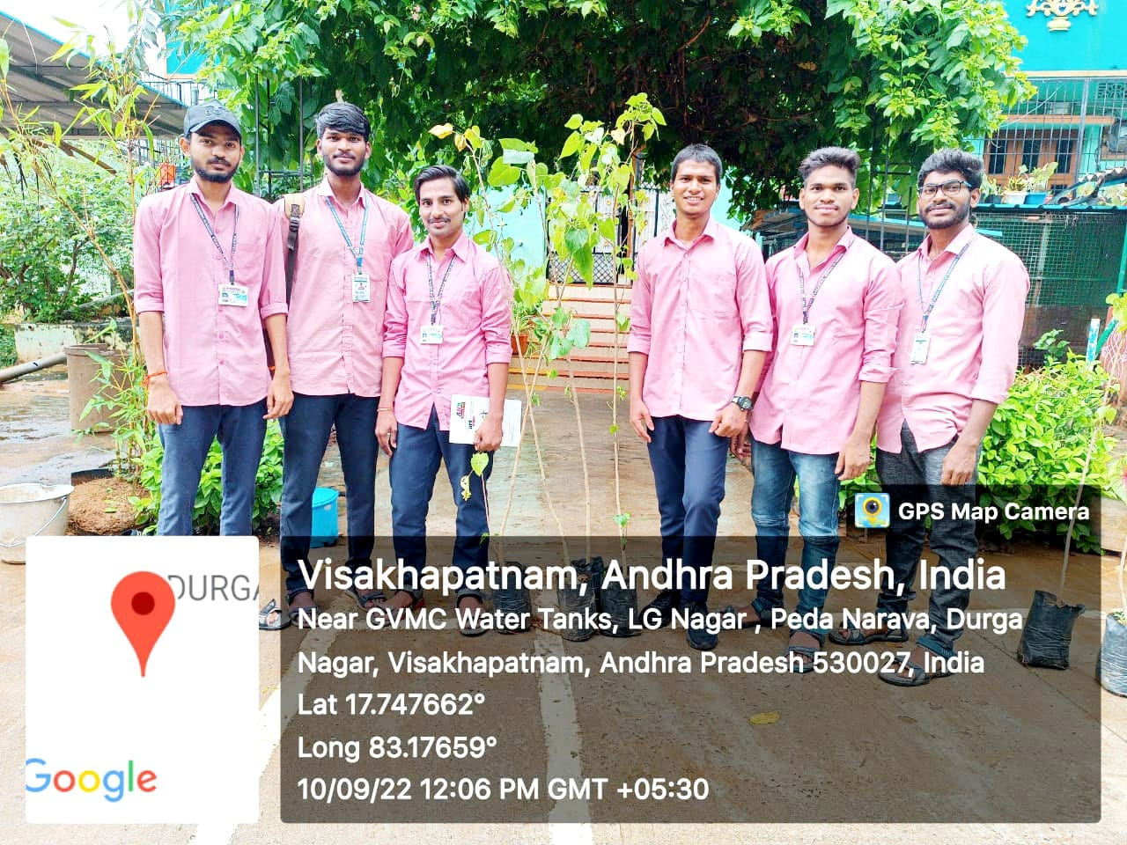
IMPLEMENTATION OF COMMUNITY SERVICE PROJECT
I had the pleasure of a day of tree planting with nearly 10 graduate students, their partners, and Laura de olden of the graduate program office on Saturday, oct.10.This was one of many community building events our graduate students are participating in this year – connecting with each other and with staff and faculty outside the (often) virtual classroom.
We worked in shifts for nearly five hours at the cedar ridge preserve in Hopewell, a beautiful green space right in Princeton’s backyard. This event was part of a series of tree plantings organized by the local D&R Greenway Land Trust, which conserves more than 20,000 acres of land in central new jersey.

Slide 7
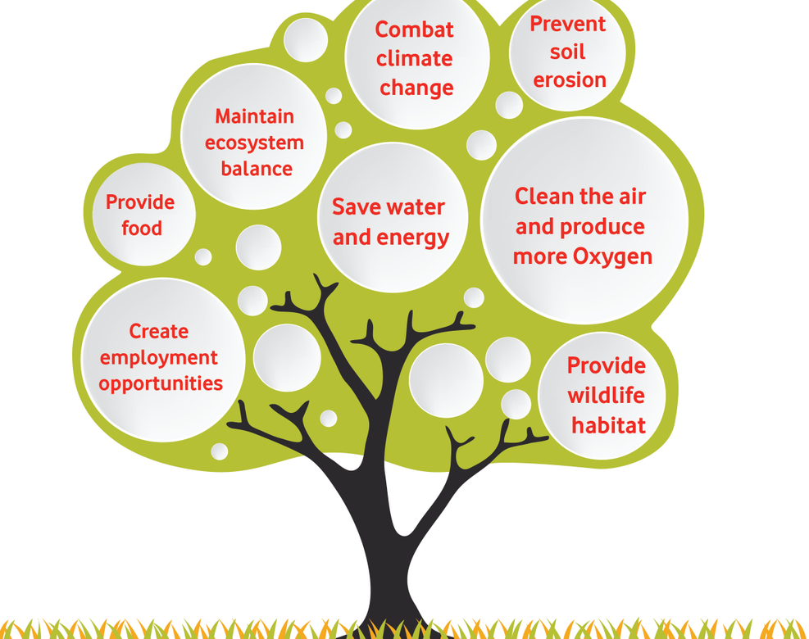
Community Service My Team Planning
The following key stages are often used when developing a community project:
1: analysis of prevailing situation
2: problem assessment
3: solicitation of public participation in prioritizing local needs
4: assessment of the finance and other resources required to implement the project
5: There is more than one way to get local projects initiated. Most approaches are interlinked and not mutually exclusive. Common to all of them is the need to plan locally the content and intended outcome of each project, in order to improve its prospects for successful implementation.
6: keeping local political leaders, community leaders and the general public informed of progress during project design and implementation.

Slide 8
Plantation Procedure
This simple exercise prepares young kids to plant trees . Begin by making cards that illustrate, either with words or drawings, the steps for tree planting (or ask the kids to draw the steps). The drawings and words are on one side on the other you or the kids can wrote an inspiring phrase such as we plant the future you can laminate the cards with clear tape to prevent damage to the drawings . The following come from peace Corps/Paraguay:
Cleaning the site
Digging a hole
Obtaining the plant
Watering the seedling

Slide 9
Simple steps to planting a tree
Removing the plant from the pot
Placing the plant in the hole
Covering the roots with soil
Gently packing the soil around the tree
Watering the plant its new home
Putting up a fence to keep animals from eating the seedling
Place the plant in the hole and back fill it with soil to cover the roots
This trick makes the most of any rain that comes which is important in our climate
Make sure the soil around the plant is firm

Slide 10
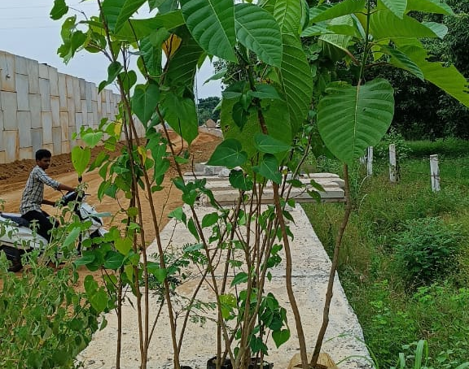
Plantation Procedure To My Team Work
Trees can be planted any time of the year that you can dig the proper planting hole. However, there are better times than others for multiple reasons.
Suffice it to say , the more time you can put between when you plant a tree, and the arrival of summer, the better. That makes fall the very best time of year to relocate trees and shrubs or plant new ones. Early spring is a popular time as well.
My Team going for Visakhapatnam in tree plantation work and trees gather to Nursery is a place where plants are propagated and grown to a desired size. Mostly the plants concerned are for gardening.

Slide 11
NINE IMPORTANT STEPS
1: Planning : Right Tree at Right Place
Right tree means the species and full grown size of the tree is best suited for your home and the area you have available to plant the tree.
Right place means the tree has enough space to grow to its full, mature height , and its root system has the space it needs to grow fully without interfering with surrounding infrastructure or underground pipes or utility lines.
Don’t forget to plant to the west or east of your building to help reduce energy costs and save energy.

Slide 12
2:Dig a proper planting hole.
Once you select the prepare place and gather equipment to dig a planting hole. When preparing any hole for planting, make it three times wider than the current root mass but never deeper than the plant was growing in its previous environment.
An even better guide with trees is to look for the flare of the trunk near the soil level. Don’t place the tree in the planting hole so deep that any part of that flare is covered with soil.
The truth is, even nurseries sometimes put plants in containers too deeply. Make a habit of checking this.

Slide 13
3: Ensure root ball is 1-2 above soil.
Placing trees and shrubs in their new environment with up to 25% of the root ball higher than the surrounding soil level.
Then taper soil up to cover all the roots and add a generous layer of mulch above that. Newly disturbed soil tends to settle, and shrubs and trees planted at grade can quickly settle, and grade and succund to root rot or disease.
4: LOOSEN OUTSIDE ROOT FROM ROOT BALL
Once the plant is out of its container, look at the roots. If they are densely bound in a circular pattern or have started growing in the shape of the container (even slightly), break up the pattern.

Slide 14
5: Don’t amend the soil.
Contrary to traditional planting methods, contemporary research indicates that you should not amend the hole with additional organic material (unless you intend to amend the entire area where roots will eventually grow). Roots growing in amended soil rarely venture into harder native soil. The long-term affect is a smaller root system, reduced growth and a less hardy plant.
6: ELIMINATE AIR POCKETS
While you could lightly tamp or hand-pack the soil around the plant roots to ensure good soil-to-root contact, I prefer to add a stiff spray of water to the hole after back filling halfway.

Slide 15
7:Mulching
Help save water and promotes healthy root growth . Placing mulch like wood chips around the base of your tree has many benefits , from reducing temperature , to keeping out weeds , to protecting from moisture extremes.
8:WATER PROPERLY UNTIL ESTSBLISHED.
The most important job you will have after planting is to keep plants and trees well-watered until establish.
9:FERTILIZING
If you plant to fertilize , I don’t suggest doing so until you know your trees or shrubs have taken to their new environment through successful establishment.

Slide 16
EXPECTED OUTCOMES
Unintended negative effects:
Reduced water supply
Destruction of native grasslands and spread of invasive tree species
Increased social inequity
Displacement of farmland
Increased deforestation
Potential beneficial outcomes:
Greater carbon and water storage
Reduced soil erosion
Increased landscape connectivity and native biodiversity
Provision of food, wood, and shade
Income generation.

Slide 17
TIME FRAME FOR THE COMMUNITY SERVICE PROJECT
Schedule:
Socio-Economic survey of the village/Habitation : A group of students under the guidance of faculty mentors conduct a socioeconomic survey of the village . They will interact with people to acquire basic knowledge on the project chosen for study and conduct the survey using a structured questionnaire.
Community awareness campaign : my team group takes up community awareness campaigns based on the above survey conducted by identifying the problems or vulnerable issues. That selection to tree plantation .
Main project: A group of my team numbers choose a topic related to their subject area and conduct a project which includes, data collection, interviews, internship in computer science engineering.
Report preparation: The team work should submit a project report duly signed by the mentor.

Slide 18
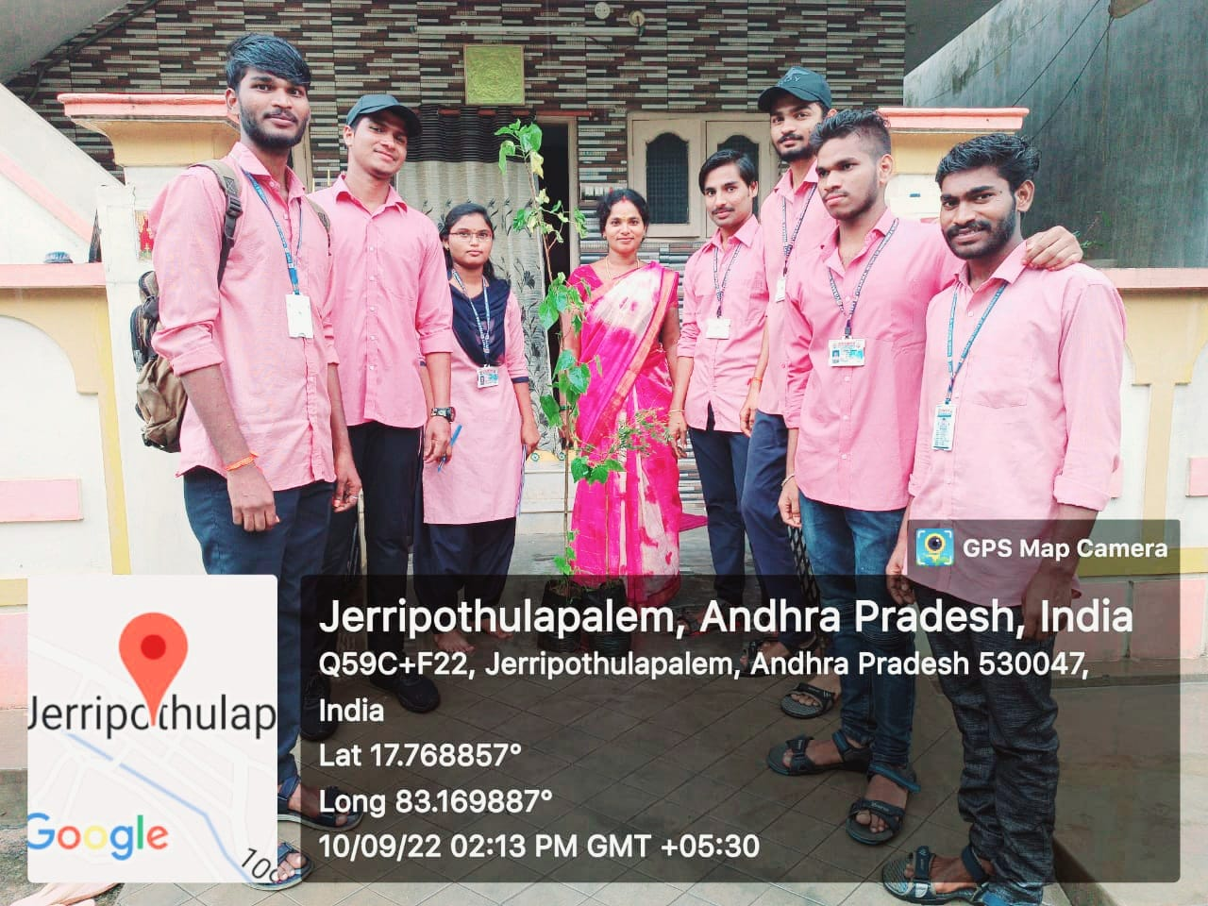
Complimenting the community service project the my team be involved to take up some awareness
That my team going for village in Visakhapatnam tree plantation of the awareness and importance of tree plantation is becoming more apparent as we observe the deterioration of the forests and the ecosystem.
Soon after the inauguration the plantation drive started and the saplings were planted together by the my team work in computer students of Visakhapatnam.
Set a good motivation for your tree planting activity.
Imagine a better world not just for you and you family but for all living beings.

Slide 19
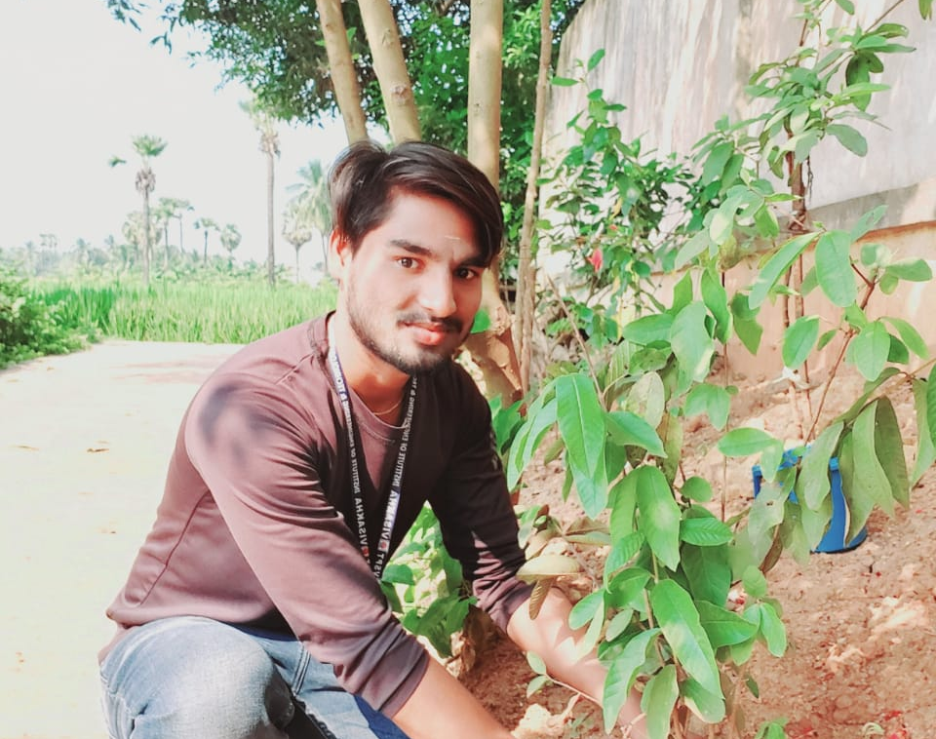
DEDICATE:
After planting and caring for your tree, mentally seal in the whale process. Think, “May the world be a better place due to this tree planting activity” and include any of your personal dedicated wishes too.
Delight in your efforts and celebrate. With this thought in your mind, ignite a feeling of joy in your heart. A job well delight to swell from the depths of your heart. Your one individual action, coupled with the same individual actions done by thousands and millions around the plant contains the seeds that can change our world.

Slide 20
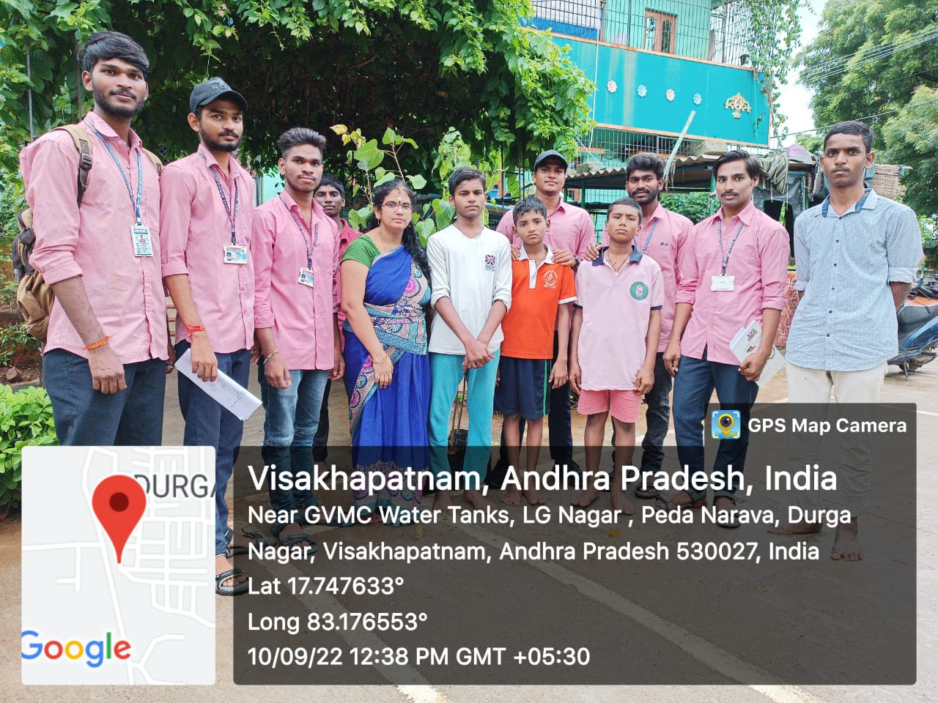
Planting Trees of village Awareness
Trees are the main source of oxygen.
An average tree produces enough oxygen to fulfil the oxygen need of four people.
Trees help in absorbing dust and other pollutants from the air, thus cleaning it.
The land under the tree absorbs more rainwater and helps prevent floods.
Trees also absorb a considerable amount of sound and help reducing noise pollution.
Birds lay their eggs in the nests on the tree, thus trees also help in nurturing many species.

Slide 21
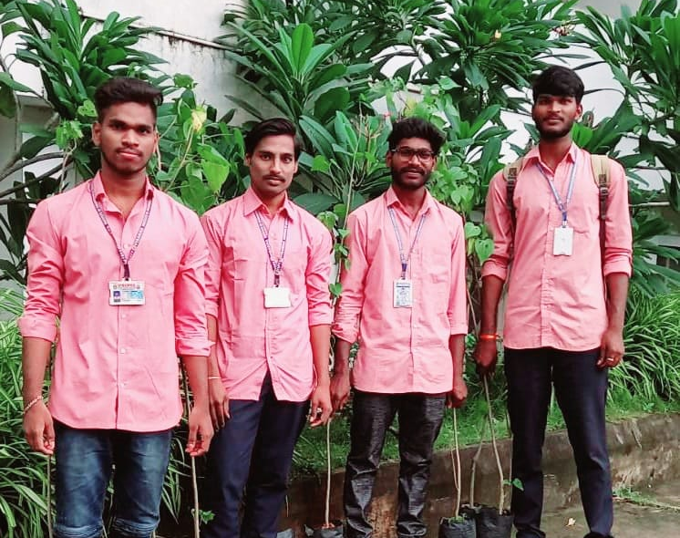
Benefits of planting trees in team work
Many trees also have medicinal properties and are used in healthcare industries.
They also save us from the harmful ultra violet rays. Which is responsible for skin cancer.
Trees are also important for many industries, like timber, paper, rubber, silk etc…., helping in economic development.
From roots to leaves, every part of a tree is beneficial to us…
Trees are very important for life on our plant.

Slide 22
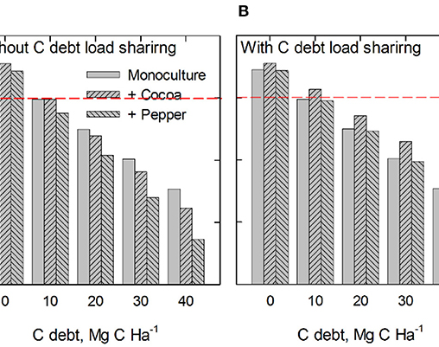
ANALYZING OF TREE PLANTATION GRAPH
In graph theory , a tree is an undirected graph in which any two vertices are connected by exactly one path or equivalently a connected acyclic undirected graph.
A tree represents hierarchical structure in a graphical form.
The elements of trees are called their nodes and the edges of the tree are called branches.
A tree with n vertices has (n-1) edges.
Trees provide many useful applications as simple as a family tree to as complex as trees in data structures of computer science.
This Photo by Unknown Author is licensed under CC BY

Slide 23


